Slide 1
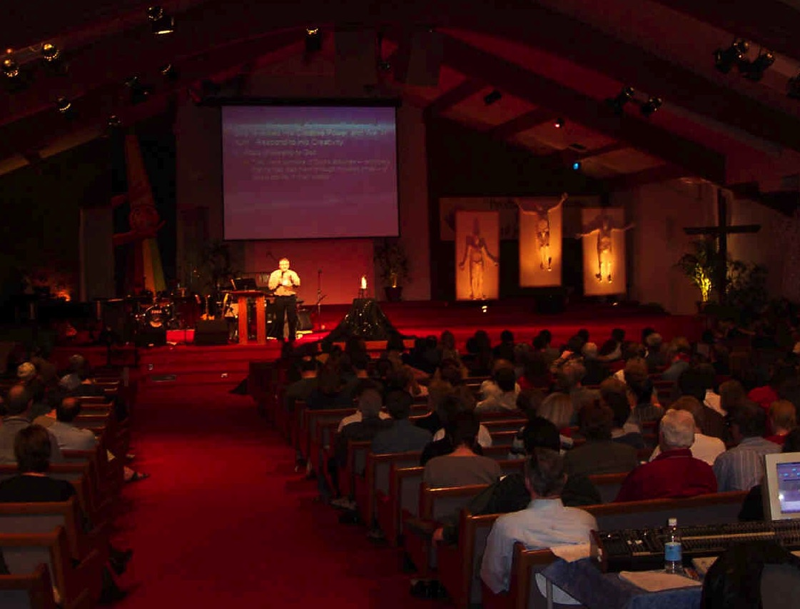
Din maraa padbo Kawicham dinron
3
Kawibo
Wangtang rabo bam
Kamkungbo
Nthaiting tadnabo jai ali
Dr. Rick Griffith, Singapore Bible College
BibleStudyDownloads.org

Slide 2
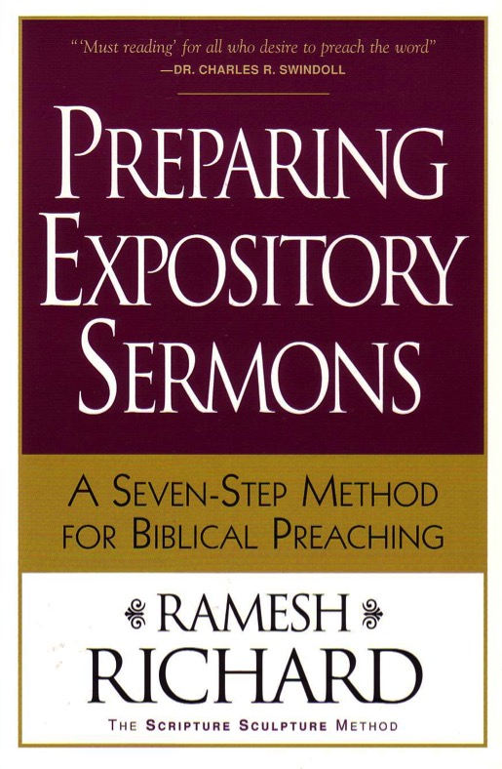
Ariak pabo maniu kasiabo
Nthainai gu ariak pa boga nde niu para thiu jiu nang tu nkha khai lo?
Nang nde gu maniu ni bo bam lo?
Kadinbo Din maraa pad ra Kadincham
Chania pakak pathak masanbo kawicham dinron bo ga

Slide 3
Kadinbo Din maraa pad tacham paorun bo tadkiubo thak
251 (cf. 27-28)
Gasu Ramesh Richard, kadinbo din maraa pad tacham paorun
Ariak
Tacham
5 lunibo nkingmainiu kenkak
Nawa
Sum muikhang
rabo maniubo
Kamaruang bogu pageng
3.2 Maning masuk
makum
CPT
namalung
CPS
6 Tacham dinbo makum
7 Tacham din
bo pariang
8 Masan siak
9 Pisikhai/Loibo
3.1 Maning Masuk
pariang
Palun jai
Naraku
Palun jai
2 Phuimui ariak
Ariak pabo
Nachia
Dinronbo
10 MSS &
Paorunbo
1 Ariak kadabo
Kaka bo ariak len 10 pakak khoipad Haddon Robinson, Masanbo Kawicham dinrun
Dr. Rick Griffith • Singapore Bible College • BibleStudyDownloads.org
Notes:
This diagram on page 251 shows how to prepare a sermon based on one passage, going from text to sermon. Ramesh Richard compares this to the human body, which starts on the outside (flesh) with words of the text and ends up back on the outside but with words of the speaker. Between these points must come an outline on which to hang these words, whether it be the structure of the text or of the sermon. The heart controls or pumps the flow of blood and should sum up the entire text/sermon, whereas using the brain helps us see the purpose of the EI (CPT) converted to the MI (CPS) to give direction to the message in terms of what to explain, prove or apply (3 Developmental Questions). These "body parts" match a parallel structure of the seven steps in the purple blocks. Haddon Robinson teaches a bit more complicated series of 10 steps that start and lead to the same purpose of preaching from the text. A two-page explanation of this 7-step process is on pages 27-28 of the course notes.

Slide 4
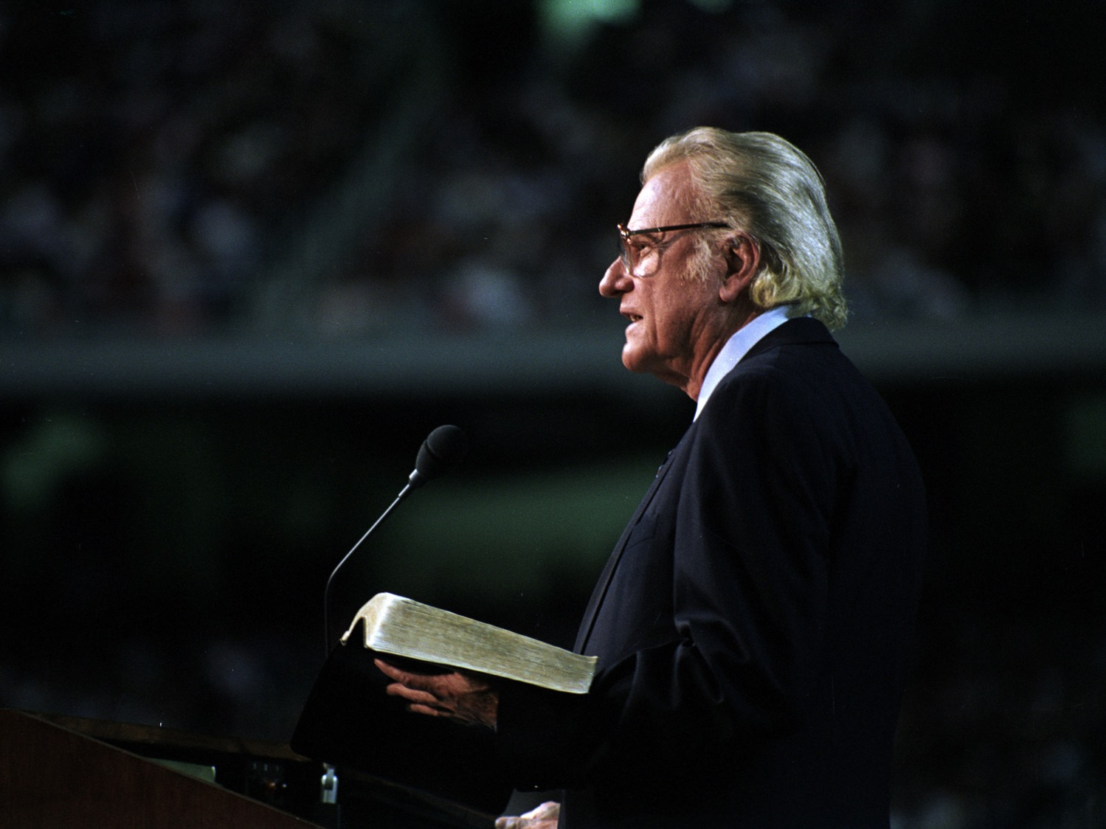
Kawibo gu Din maraa pad
3
Manang makbo

Slide 5
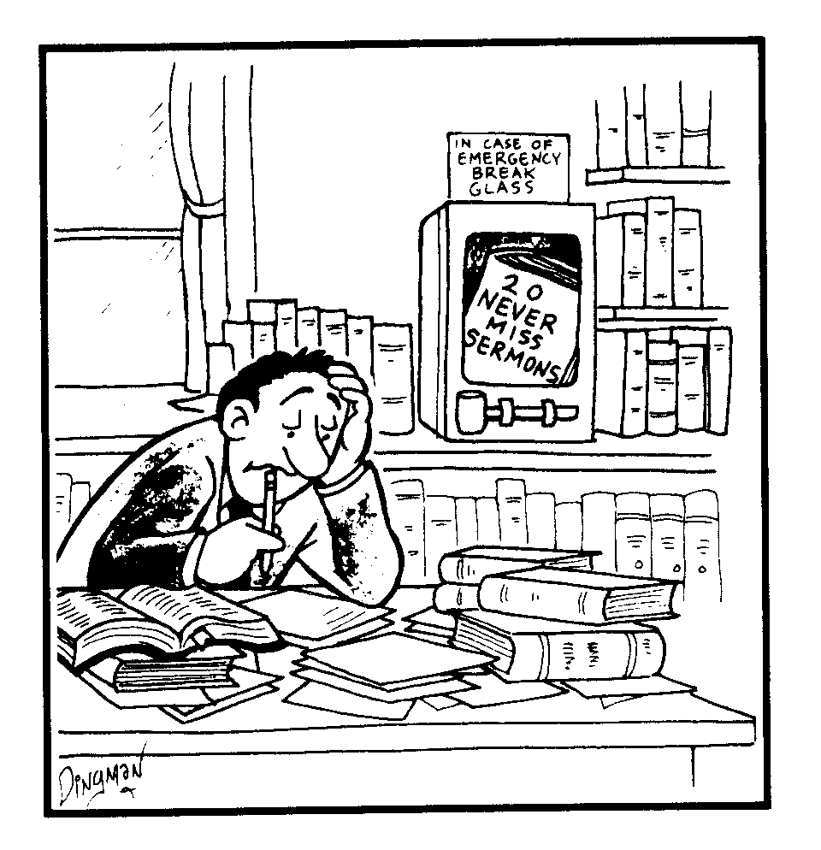
20 kamdu lo soimak tacham
Pu kanangbo ting ga chahiu se kam pang lo
Notes:
Translate the two titles

Slide 6
Kawibo gu Din maraa padbo
3
Manang makbo
Tambo ladpui
Machambo
Thin piu rabo
Palun jai

Slide 7
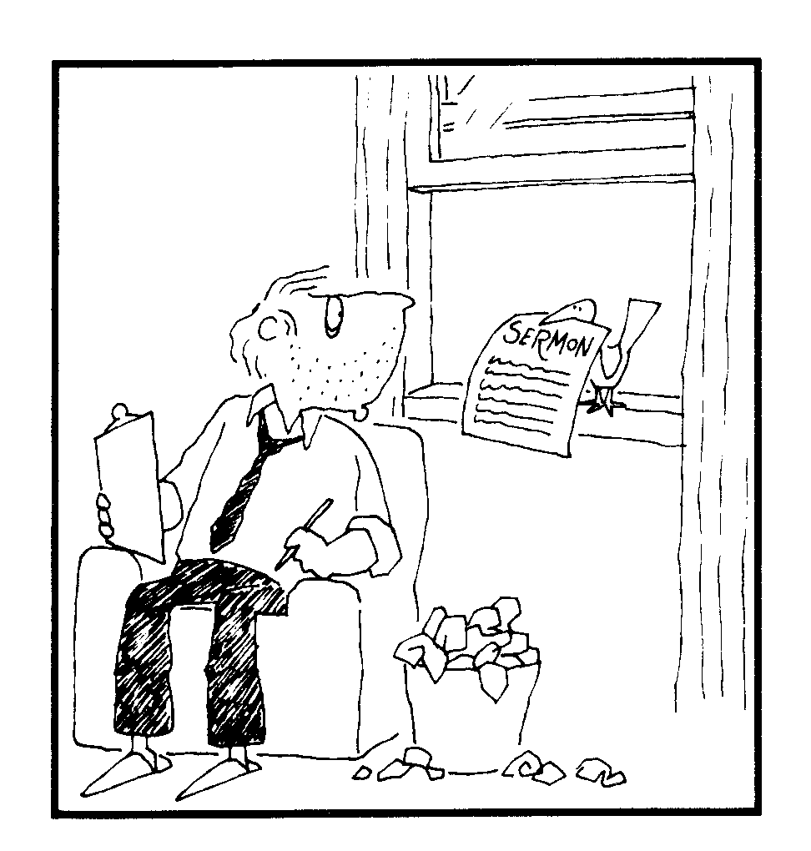
Bird Delivery
Tacham

Slide 8
Kawibo Din maraa padbo
3
Manang makbo
Tambo ladpui
Machambo
Thin piubo
Palun jai
Tambo sanaung
Wa khat lin khaibo
Pawan thinsibo
Kawicham dinpou tu mui khai
Kadinkhaibo malummaitu
Miria leng wibo

Slide 9
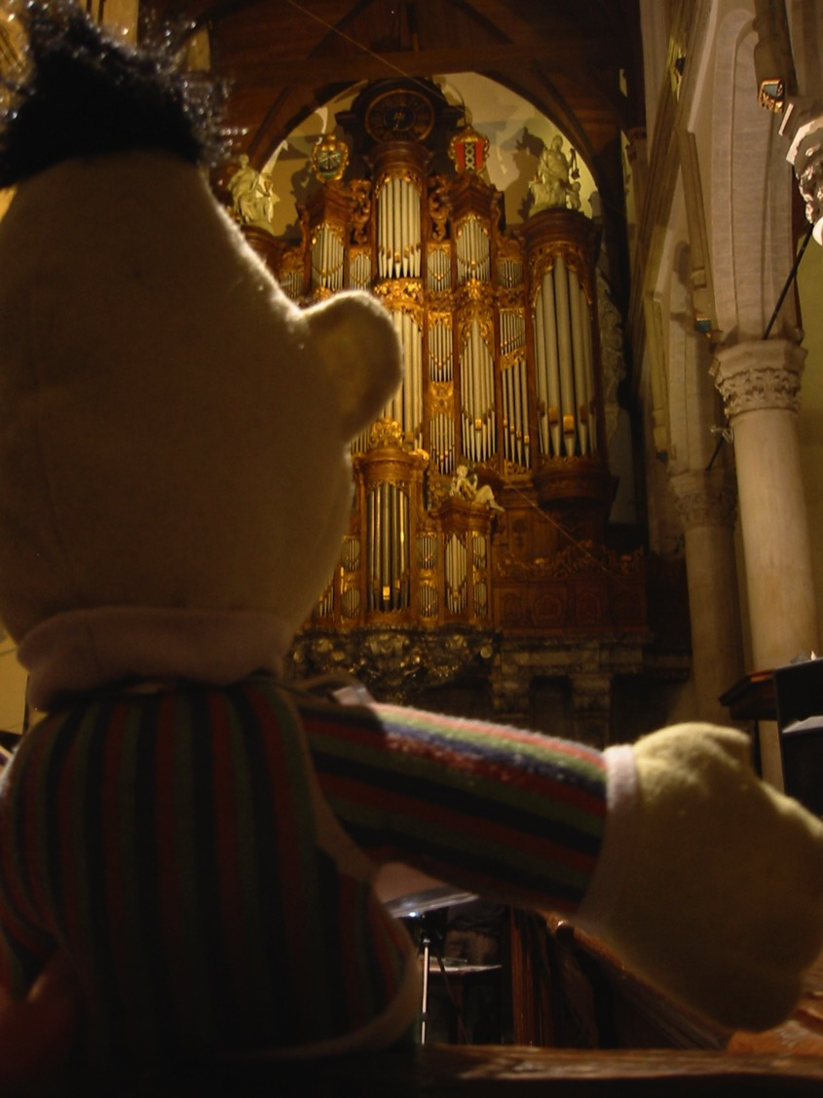
Din maraa padbo kawicham dinron bose silubo kamsi
Napoi niu di kam lubo!

Slide 10
Din maraa padbo gu wang tang ra bam
3
Masanbo lad pou pad bo
Chamai niu lunibo dou khai
Tingwang chunning silen khai

Slide 11
Decisions
“ BARCLAY MAKSAI BROADMAN? SPURGEON MAKSAI WIERSBE? ROBERTSON MAKSAI KITTEL? PHAIMUIKAKUNG MAKSAI KAWICHAM DINRONBO? CHALUNG KALI MAKSAI LUNGSABO? MASAN BOBAM MAIDUNG TU CHAKHUANG THIU MAKSAI KAWICHAM DIN RON
CHAPKHAIBO, CHAPKHAIBO, CHAPKHAIBO

Slide 12
Din maraa padbo gu wang tang ra bam
3
Masanbo lad pou pad bo
Chamai niu lunibo dou khai
Tingwang chunning silen khai
Kachukhai malumtu, Kadinpiubo, & Muikhangbo
Katikhai agu malum lam maksai Tingwang lam ga katibo

Slide 13
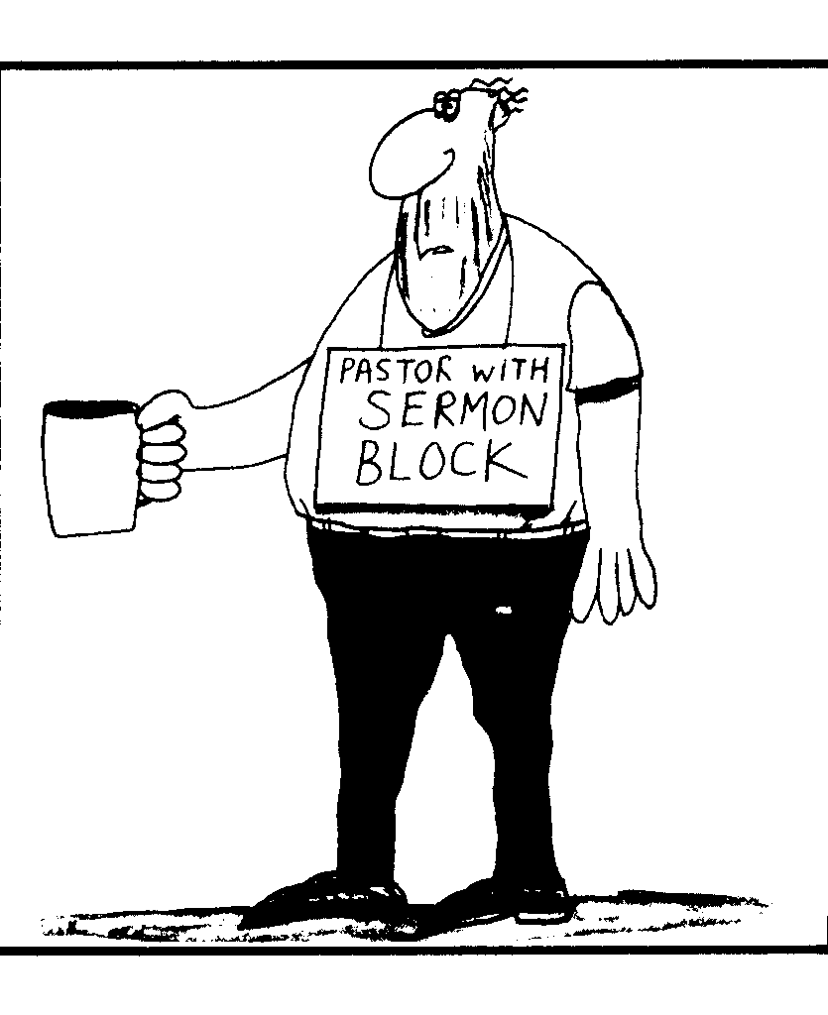
Sermon Block
KHRISTA SINGKU GU TACHAM KHAMBO

Slide 14
Din maraa padbo gu wang tang ra bam
3
Masanbo lad pou pad bo
Chamai niu lunibo dou khai
Tingwang chunning silen khai
Kachukhai malumtu, Kadinpiubo, & Muikhangbo
Katikhai agu malum lam maksai Tingwang lam ga katibo
Kahumbo Tingwang tu & Pajan tu kam maku khaibo
Nuan se sikhaibo khatdi lungsa khaisan khangbo

Slide 15
Kam kungbo Din maraa padbo lam
4
Ariak kin diang ra
Dinchali mui bo jai kam ra

Slide 16
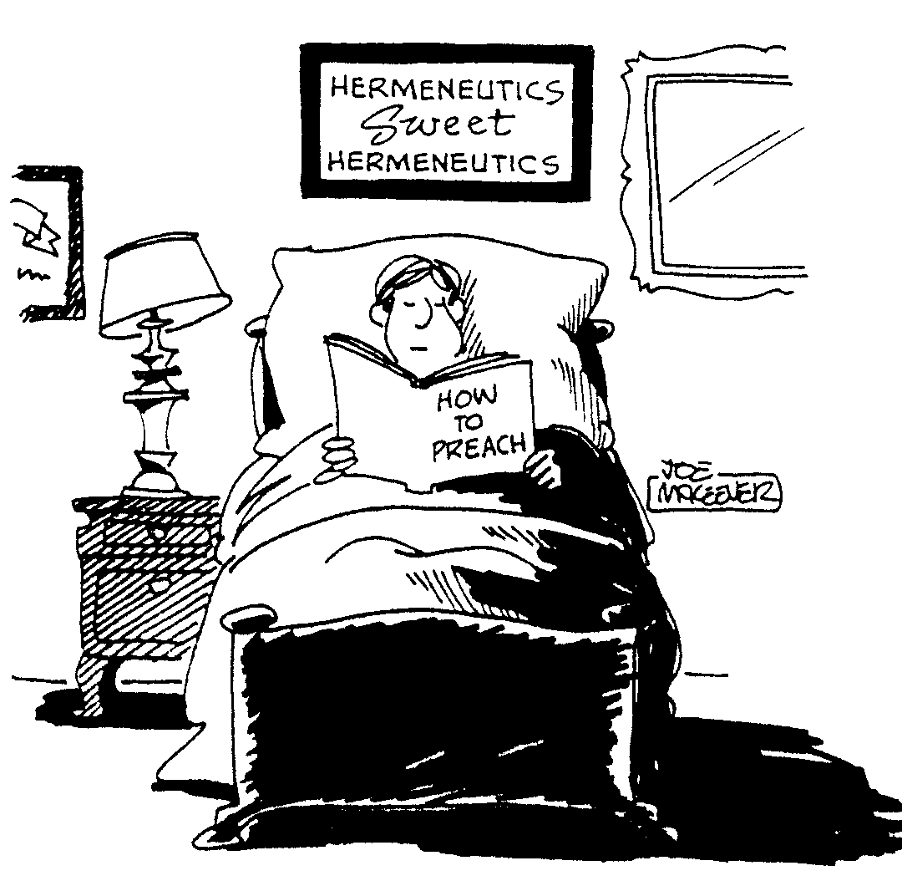
Hermeneutics
DIN CHALI MUI
HUMBO
DIN CHALI MUI
NDE
TIU
DIN RON RA

Slide 17
Kam kungbo Din maraa padbo lam
4
Ariak kin diangbo jou ra
Dinchali mui bo jai jou ra
Pawan jeng se jou ra
Ariak roubo jai ali jou ra
Nting sibo jou ra

Slide 18
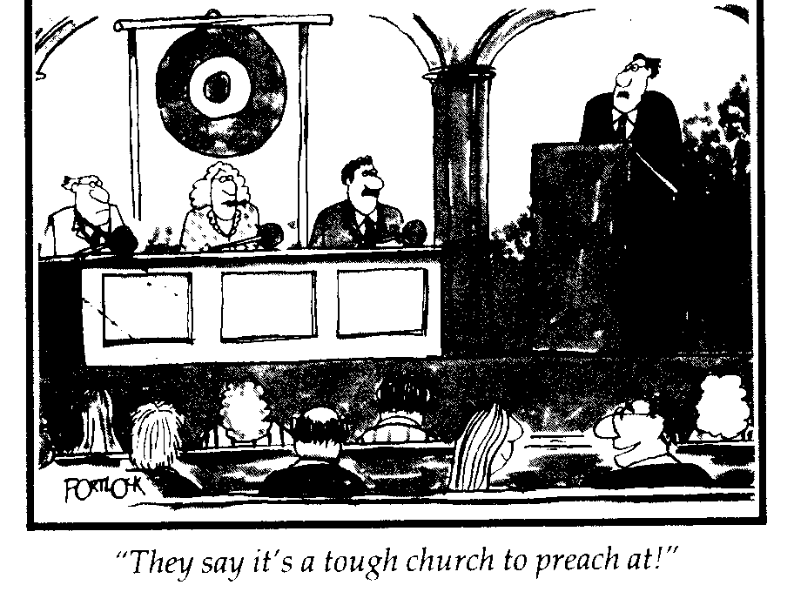
Gong Church
“Paliu din-e haise kamkungbo ladin ra charakiga!"
Notes:
"The Gong Show" in the USA is known for short acts where a judge can immediately stop the singer or speaker by hitting the gong if the act is too painful!

Slide 19
Kam kungbo Din maraa padbo lam
4
Ariak kin diangbo jou ra
Dinchali mui bo jai jou ra
Pawan jeng se jou ra
Ariak roubo jai ali jou ra
Nting sibo jou ra
Para kathiu makum to changam ngou jou ra

Slide 20
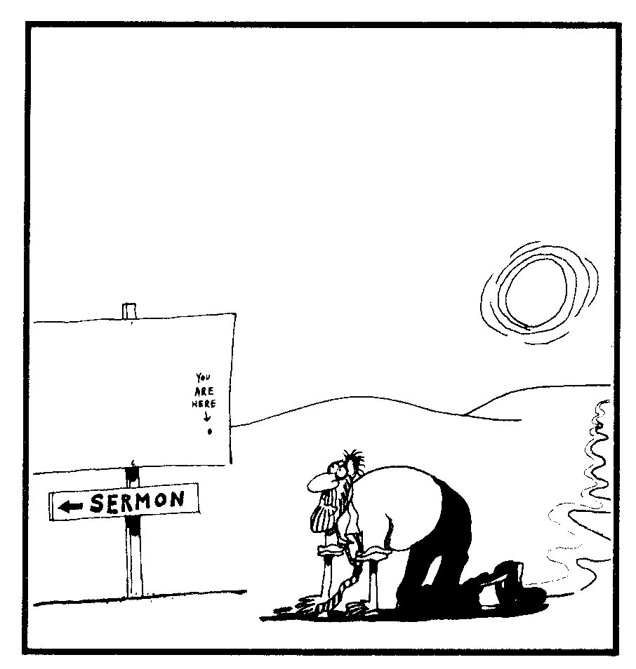
Desert Sermon
NANG
HAIGA
BAM
TACHAM

Slide 21
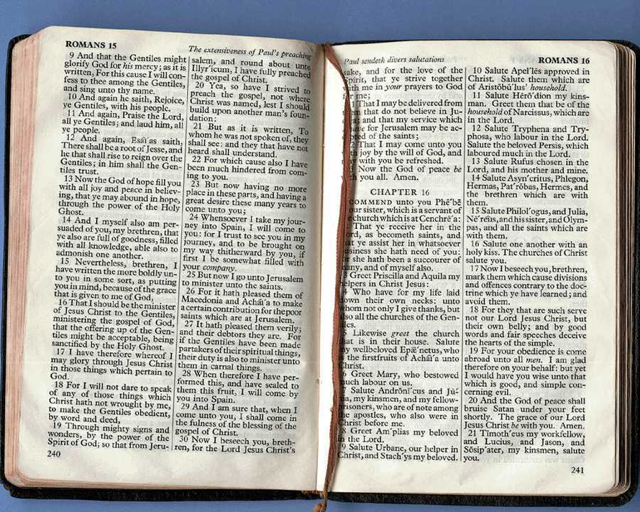
Ndetiu bojai ga niu Din maraa padbo kawicham paorun bo se nthai ting nai chamlura?
4
Ndetiu ja aliu pakak se jutaruang khai ra nda ting nai nthai ting tu ncham jiu tadnalura

Slide 22
Ndetiu bojai ga niu Din maraa padbo kawicham paorun bo se nthai ting nai chamlura?
4
A. Sira nia jai ali si muira
Ndetiu?
Ndating
Nthaiting
Notes:
Tell your neighbor two ideas HOW you can better know your people.

Slide 23
Ndetiu bojai ga niu Din maraa padbo kawicham paorun bo se nthai ting nai chamlura?
4
B. Kawicham dinronbo se karingting gu thakse niu pamaga kadapadbo majibose.

Slide 24
Ndetiu bojai ga niu Din maraa padbo kawicham paorun bo se nthai ting nai chamlura?
4
C. Kam macham khai pakak ga pabam khaibo thak khatdi nthai ting gu jai

Slide 25
Black

Slide 26
Kawicham paoron (Kawicham paoron Pathak pajai) link at BibleStudyDownloads.org
Paman thiu mak jiu haise ngou lune!
Notes:
Preaching (pr)
Homiletics

